Slide 1

Department of CE
01CE0101 - Computer Programming
Unit - 6
Structure and union

Slide 2
Structures

Slide 3
Structure
Arrays allow to define type of variables that can hold several data items of the same kind.
Similarly, structure is another user defined data type available in C that allows to combine data items of different kinds.
Structures are used to represent a record.

Slide 4
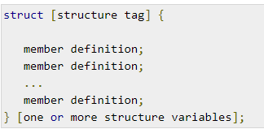
Defining a Structure
To define a structure, you must use the struct keyword.
The struct keyword defines a new data type, with more than one member.
The format of the struct statement is as follows

Slide 5
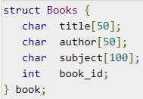
Example

Slide 6
Accessing Structure Members
To access any member of a structure, we use the member access operator (.)
The member access operator is coded as a period between the structure variable name and the structure member that we wish to access.
You would use the keyword struct to define variables of structure type.

Slide 7
Example of Structure
#include <stdio.h>
struct Person {
char name[50];
int age;
float height;
};
int main()
{
struct Person person1;
printf("Enter name: ");
scanf("%s", &person1.name);

Slide 8
Example of Structure
printf("Enter age: ");
scanf("%d", &person1.age);
printf("Enter height (in meters): ");
scanf("%f", &person1.height);
// printing details of person1
printf("\nName: %s\n", person1.name);
printf("Age: %d\n", person1.age);
printf("Height: %.2f meters\n", person1.height);
return 0;
}

Slide 9
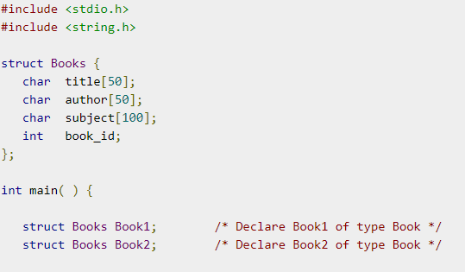
Example Program

Slide 10
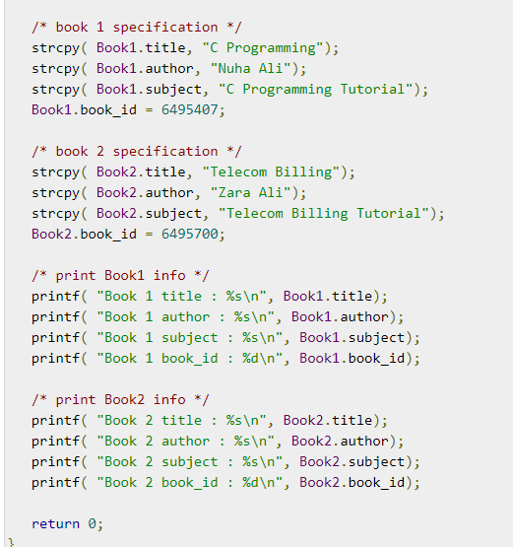
Example Program

Slide 11
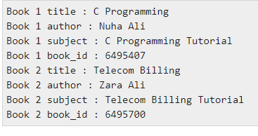
Program output

Slide 12
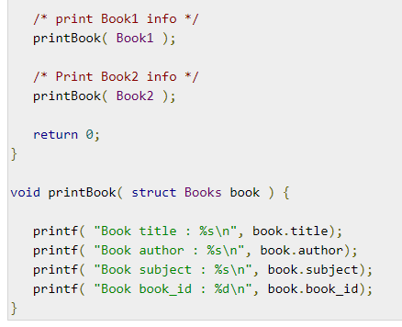
Structures as Function Arguments
You can pass a structure as a function argument in the same way as you pass any other variable or pointer.

Slide 13
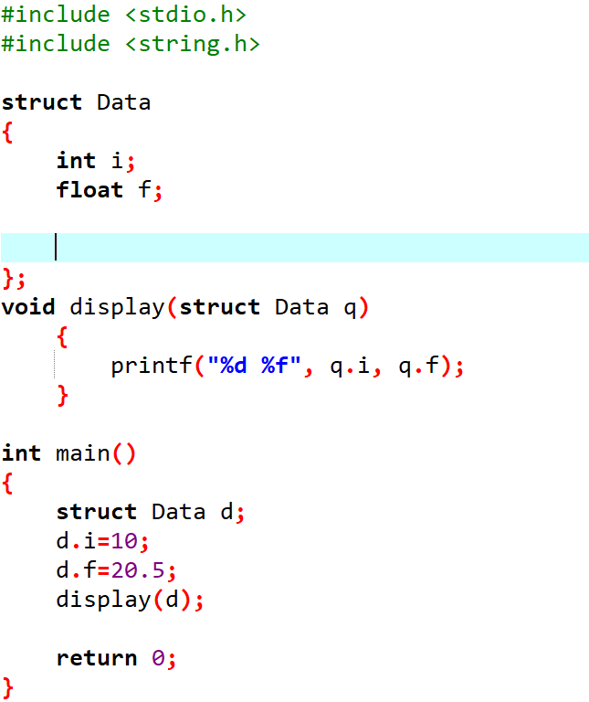
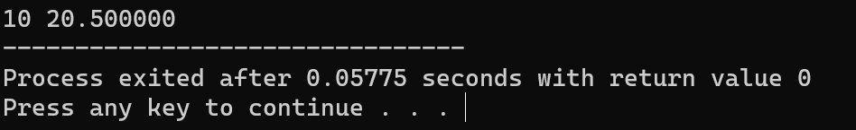
Program
You can pass a structure as a function argument in the same way as you pass any other variable or pointer(Call by Value).

Slide 14
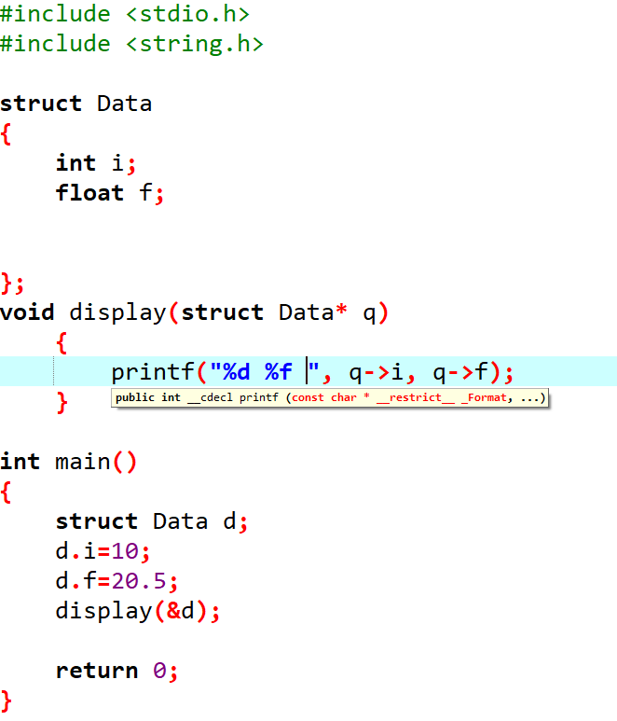
Program
You can pass a structure as a function argument in the same way as you pass any other variable or pointer(Call by Reference).
The arrow operator (->) is used to access the members when using a pointer to a structure (e.g., q->i, q->f).

Slide 15
Union

Slide 16
Union
A union is a special data type available in C that allows to store different data types in the same memory location.
You can define a union with many members, but only one member can contain a value at any given time.
Unions provide an efficient way of using the same memory location for multiple-purpose.

Slide 17
Defining a Union
To define a union, you must use the union keyword in the same way as you did while defining a structure.
The union statement defines a new data type with more than one member for your program.

Slide 18
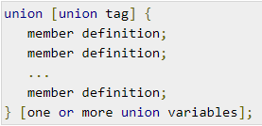
Defining a Union
The format of the union statement is as follows
Each member definition is a normal variable definition, such as int i; or float f; or any other valid variable definition.
At the end of the union's definition, before the final semicolon, you can specify one or more union variables but it is optional.

Slide 19
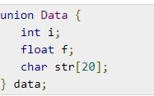
Defining a Union
Now, a variable of Data type can store an integer, a floating-point number, or a string of characters.
It means a single variable, i.e., same memory location, can be used to store multiple types of data.

Slide 20
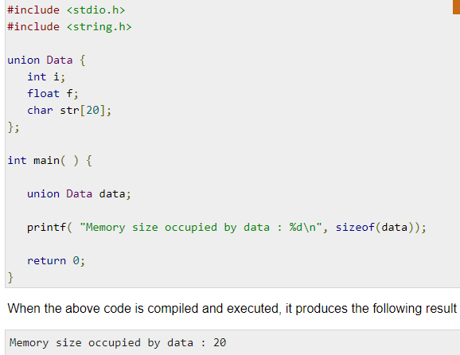
Example

Slide 21
Accessing Union Members
To access any member of a union, we use the member access operator (.).
The member access operator is coded as a period between the union variable name and the union member that we wish to access.
You would use the keyword union to define variables of union type.

Slide 22
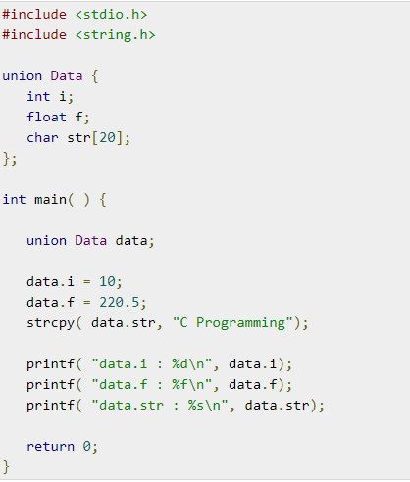

Example program

Slide 23
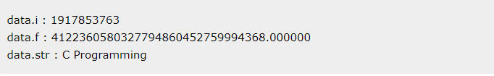
Output of program

Slide 24
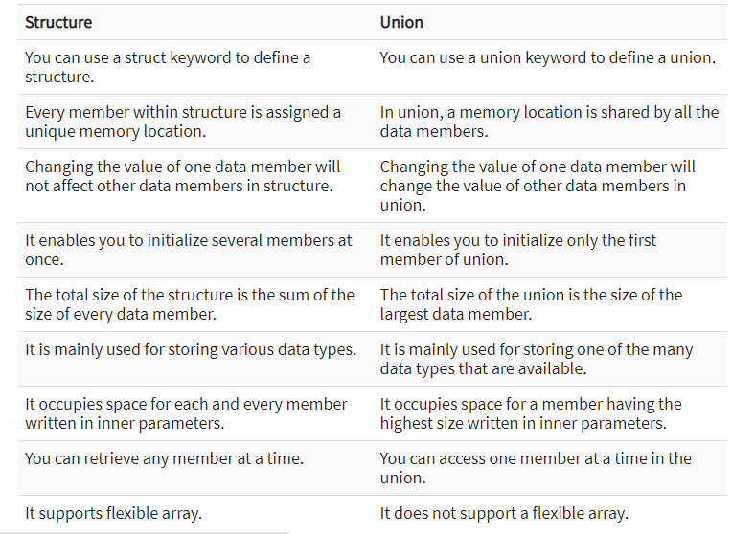
Difference between structure and union

Slide 25
Advantages of structure
Structures gather more than one piece of data about the same subject together in the same place.
It is helpful when you want to gather the data of similar data types and parameters like first name, last name, etc.
It is very easy to maintain as we can represent the whole record by using a single name.
In structure, we can pass complete set of records to any function using a single parameter.
You can use an array of structure to store more records with similar types.

Slide 26
Disadvantages of structure
Change of one data structure in a code necessitates changes at many other places. Therefore, the changes become hard to track.
Structure is slower because it requires storage space for all the data.
You can retrieve any member at a time in structure whereas you can access one member at a time in the union.
Structure occupies space for each and every member written in inner parameters while union occupies space for a member having the highest size written in inner parameters.
Structure supports flexible array. Union does not support a flexible array.

Slide 27
Advantages of union
It occupies less memory compared to structure.
When you use union, only the last variable can be directly accessed.
Union is used when you have to use the same memory location for two or more data members.
It enables you to hold data of only one data member.
Its allocated space is equal to maximum size of the data member.

Slide 28
Disadvantages of union
You can use only one union member at a time.
All the union variables cannot be initialized or used with varying values at a time.
Union assigns one common storage space for all its members.

Slide 29
That’s All….
Thank you!!!

